Slide 1
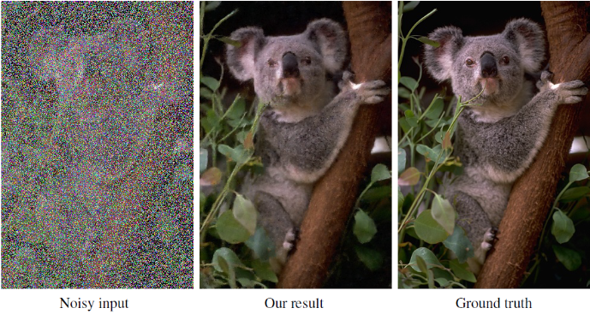
Image Restoration without Clean Data
EC838 - Mini Project in Image Processing : Mid Semester Evaluation
Team Members:
Inbasekaran Perumal
Pranav Koundinya
Project Guide:
Prof. Sumam David S
Notes:
How many times have we taken photos from our phone that turned out being really blurred out? Maybe the person or animal moved at the last minute, or perhaps the light was really low and the shot ended up being dark and grainy. I could go on and on.
So Image denoising is an area where we give a noisy image an input and we wish to get a clear noise free image as output.
Neural network models are amazing at this because we feed them a large amount of data and with noisy inputs and clear outputs, if we do that the NN will be able to learn the concept of noise and when presented with a new previously unseen noisy image, It’ll be able to clear it up .
Explain the problem of creating a noise less image set.
Using the power of deep learning, NVDIA in collaboration with MIT and Alto university have developed an algorithm, called Noise2Noise, that can fix bad images by learning from corrupted images only. It’s a pretty unique approach to image processing. The official implementation trained the model on ImageNet dataset with 50,000 images, using TF along with cuDNN accclerator. Normally we would say its impossible and end this project. However under suitable constraints like knowing the distribution of noise opens up the possibility of restoring noisy signals without seeing the clean one. It has also been shown that this technique can do close to as nearly as good as the classical denoising neural networks.

Slide 2



Overview
Conventional approach to denoising:
Our approach:
Assumptions/ Validity:

Slide 3
Our take on this
Conventional approach requires clean images for training purposes.
NVIDIA’s approach doesn't need clean and HQ images to feed the NN.
Takes milliseconds to render the new image.
It can be potentially be used in healthcare to restore MRI scan images or in satellite imagery.
There is also a dark side to this, can be used to remove text noise which presents a significant problem for copyright infringement.

Slide 4
Model
Architecture: REDNet (Mao et. al, 2016) and UNet(Ronneberger et.al, 2015)
Dataset : BSD Images (Train:Test = 200:200)
Loss Function : Mean Squared Error
Optimizer: Adam (Kingma et. al, 2015)
Training metric: Accuracy
Evaluation Metric: Peak Signal-to-Noise Ratio (PSNR)
Notes:
Berkeley Segmentation Dataset

Slide 5
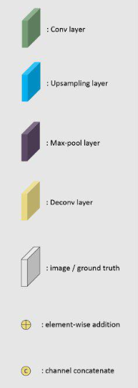
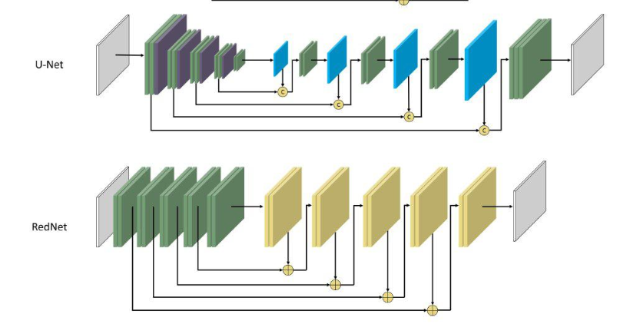
UNet and REDNet: A comparison

Slide 6
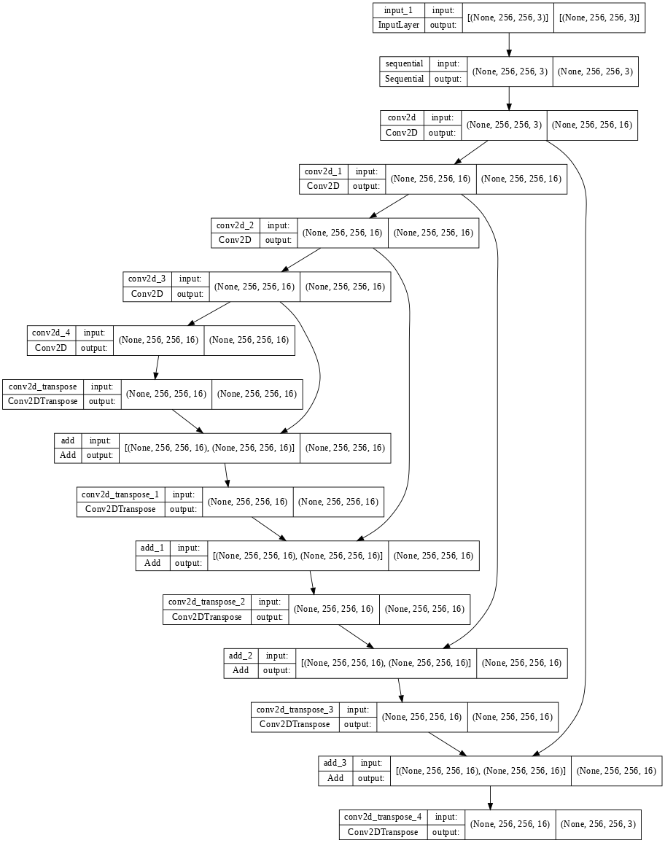
REDNet

Slide 7
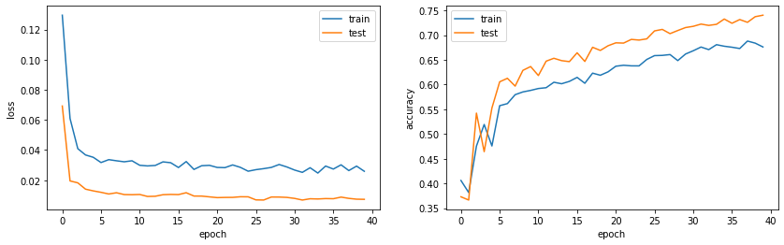
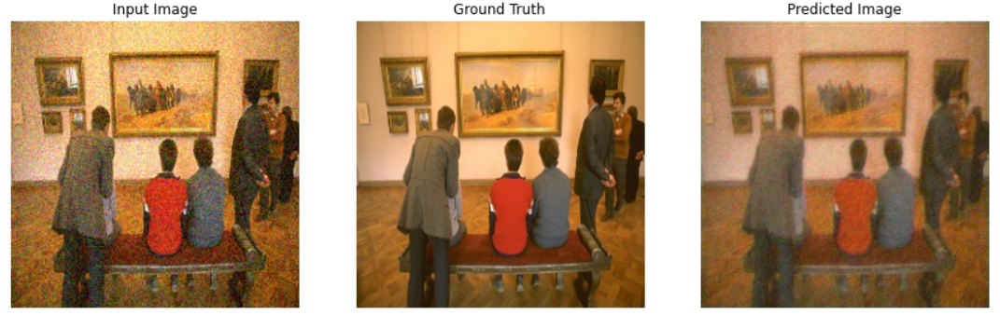
Results(REDNet Architecture)
Mean PSNR: 30.259653733162992 dB
Epoch 40 -> Loss: 0.0259 Accuracy: 0.6760
Gaussian noise introduced during training
mean = 0
var = 0.01
sigma = var**0.5

Slide 8
Upcoming Goals
Improve on the current results
Train the model to denoise other noises (Bernoulli, Poisson etc.)
Explore the effect of amount of initial noise to the PSNR of the denoised image
Hardware implementation of the model on an embedded device.

Slide 9
References
Jaakko Lehtinen, Jacob Munkberg, Jon Hasselgren, Samuli Laine, Tero Karras, Miika Aittala,and Timo Aila. Noise2Noise: Learning Image Restoration without Clean Data. Proceedings of the 35th International Conference on Machine Learning, 2018.
Xiao-Jiao Mao, Chunhua Shen, Yu-Bin Yang. Image Restoration Using Convolutional Auto-encoders with Symmetric Skip Connections, NIPS, 2016
Olaf Ronneberger, Philipp Fischer, Thomas Brox. U-Net: Convolutional Networks for Biomedical Image Segmentation, MICCAI 2015
https://github.com/SunnerLi/Simple-Hourglass
https://www.youtube.com/watch?v=P0fMwA3X5KI&t=6s
https://www.youtube.com/watch?v=dcV0OfxjrPQ
https://www.analyticsvidhya.com/blog/2018/07/nvidias-noise2noise-technique-helps-you-fix-bad-images-in-milliseconds/

